Slide 1
SA420-NATURAL RESOURCE ECONOMICS
LECTURER NAME:
MULENGA MPOLOKOSO
(Ph.D_WIP, MBA, BBA, BICTED, BSCFO, TM, ISP, CMP)

Slide 2
TOPIC 3: AGR/FOR/FISH ECONOMICS
OUTLINE OF THE CONTENT
AGRICULTURAL ECONOMICS
FORESTRY ECONOMICS
FISHERIES ECONOMICS

Slide 3
AGRICULTURAL ECONOMICS
  What is Agricultural economics?
  Agricultural economics is the exploration of how societies allocate their finite resources to produce food, fiber, and fuel for a world in constant motion.
  It delves into the decisions made by farmers as they labor under the open skies, striving to optimize their yields and livelihoods.
  It examines the behavior of consumers who fill their carts in supermarkets and the policymakers who craft the regulations that shape our food systems.
  In this unit, we will explore the dynamic interplay between economic theory and the realities of farming that lead to economic development.

Slide 4
key reasons why the study of agricultural economics is crucial:
➢ Food Security: Agricultural economics plays a pivotal role in ensuring food security. By analyzing production, distribution, and consumption patterns, it helps societies understand how to produce enough food to feed growing populations. This is particularly critical in a world where hunger and malnutrition remain significant challenges. ➢ Economic Development: Agriculture often forms the backbone of economies in many countries, especially in developing regions. The study of agricultural economics helps identify ways to enhance agricultural productivity, increase income for farmers, and stimulate overall economic growth in rural areas.

Slide 5
key reasons why the study of agricultural economics is crucial:
Resource Allocation: Agriculture relies on finite resources such as land, water, and energy. Agricultural economics helps optimize the allocation of these resources to maximize production while considering environmental sustainability and long-term resource availability.
Environmental Sustainability: Modern agriculture faces the challenge of balancing increased food production with environmental preservation. Agricultural economists contribute by researching and advocating for sustainable farming practices and policies that reduce negative environmental impacts.

Slide 6
key reasons why the study of agricultural economics is crucial:
Rural Development: Many communities rely on agriculture as their primary source of income. Agricultural economics explores strategies for rural development, job creation, and infrastructure DDE, Pondicherry University 3 Notes improvement, thus contributing to the well-being of these communities.
Trade and Global Economics: Agricultural economics is critical in understanding the dynamics of international trade in agricultural products. It informs trade policies, trade agreements, and negotiations, affecting global food supply and prices

Slide 7
CONT…
Policy Formulation: Governments and policymakers rely on agricultural economists’ expertise to design effective agricultural policies. These policies can address issues such as price stability, income support for farmers, and food safety regulations.
Risk Management: Agriculture is inherently susceptible to risks like weather events, pests, and market volatility. Agricultural economists develop risk management strategies, such as insurance and hedging mechanisms, to protect farmers and ensure stable food production.

Slide 8
CONT…
Consumer Welfare: Understanding consumer preferences and behavior is essential for food producers and policymakers. Agricultural economics helps ensure that consumers have access to safe, affordable, and nutritious food while respecting their choices.
Innovation and Technology Adoption: Agricultural economists analyze the adoption of new technologies and innovations in agriculture. This research informs decisions on research funding, extension services, and incentives to promote technological advancements in farming

Slide 9
CONT…
Food Quality and Safety: In an era of increasing concern about food safety and quality, agricultural economics examines the economic implications of food safety regulations and standards, ensuring that consumers receive high-quality, and safe food.
Human Capital Development: The study of labor markets in agriculture helps address labor-related challenges, improve working conditions, and attract talent to the agricultural sector

Slide 10
Definition:
Agricultural economics is a branch of economics that focuses on the application of economic principles and concepts to the production, distribution, and consumption of agricultural goods and services. Different economists have provided various definitions and perspectives on agricultural economics:

Slide 11
scope of Agricultural Economics-
Production Economics
Farm Management: Agricultural economists study how farmers make decisions about resource allocation, crop selection, and production techniques to maximize their profits or achieve other objectives.
Production Function Analysis: They analyze the relationship between inputs (e.g., land, labor, capital) and outputs (crop yields, livestock products) to optimize production processes.
Technology Adoption: Studying the adoption of new agricultural technologies and practices to improve productivity and sustainability

Slide 12
scope of Agricultural Economics-
Agricultural Policy ➢ Government Interventions: Assessing the effects of government policies, subsidies, price supports, and trade regulations on agricultural production and income. ➢ Environmental Policy: Evaluating policies related to land use, conservation, and environmental sustainability in agriculture. ➢ Food Security: Analyzing policies aimed at ensuring a stable and accessible food supply for the population

Slide 13
scope of Agricultural Economics-
Rural Development
➢ Rural Economy Analysis: Investigating the economic conditions of rural areas, including income distribution, employment opportunities, and infrastructure development.
➢ Agricultural Extension: Studying the role of agricultural extension services in disseminating knowledge and technology to rural communities.
International Trade
➢ Trade Policies: Analyzing international trade agreements, tariffs, and trade barriers affecting the global exchange of agricultural products.
➢ Export and Import Dynamics: Studying the balance of trade in agricultural commodities and its impact on domestic markets and economies.

Slide 14
scope of Agricultural Economics-
Environmental and Resource Economics
➢ Sustainable Agriculture: Evaluating the economic implications of sustainable farming practices and natural resource management. DDE, Pondicherry University 7 Notes
➢ Resource Allocation: Analyzing the allocation of land, water, and other resources in agriculture, considering their economic and environmental consequences

Slide 15
scope of Agricultural Economics-
Risk and Uncertainty
➢ Risk Management: Developing strategies to mitigate risks associated with weather, pests, market fluctuations, and other factors that affect agricultural outcomes.
➢ Insurance and Hedging: Analyzing the role of insurance and hedging mechanisms in protecting farmers against income volatility. Consumer Behavior
➢ Consumer Preferences: Investigating how consumer preferences and choices influence the demand for agricultural products. ➢ Food Safety and Quality: Analyzing the economic aspects of food safety regulations and quality standards

Slide 16
scope of Agricultural Economics-
Agribusiness
➢ Supply Chain Analysis: Examining the economic interactions within the agribusiness sector, including food processing, distribution, and retailing.
➢ Value Chain Management: Studying strategies for adding value to agricultural products and improving competitiveness.
Human Capital and Labor Economics
➢ Labor Market Analysis: Assessing labor market dynamics in agriculture, including wages, employment conditions, and the impact of labor policies

Slide 17
ROLES THAT AGRICULTURE FULFILLS IN ZAMBIA’S ECONOMY
Primary Source of Livelihood:
Food Security
Economic Growth:
Foreign Exchange Earnings:
Rural Development:
Poverty Alleviation:
Diversification of Income Sources:
Environmental Sustainability:

Slide 18
ROLES THAT AGRICULTURE FULFILS IN AN ECONOMY
Source of Innovation:
Climate Change Mitigation:
Raw Material Supply:
Employment Generation:
Income Generation
Foreign Exchange:

Slide 19
Factors Influencing Farm Productivity
Climate and Weather:
Weather conditions, including rainfall and temperature, play a pivotal role in crop yields and livestock productivity.
Soil Quality:
The fertility and health of soil determine the nutrient availability for crops, affecting their growth and yield.
➢ Crop Variety: The choice of crop varieties, including traditional and modern high-yielding ones, impacts productivity.
➢ Irrigation: Access to adequate and timely irrigation is crucial, especially in regions with erratic rainfall

Slide 20
Factors Influencing Farm Productivity
Technology and Inputs:
The adoption of modern technologies, quality seeds, fertilizers, and pesticides can significantly enhance productivity.
➢ Farm Size: Farm size influences the scale of agricultural operations, with larger farms having the potential for mechanization and economies of scale.
➢ Labor and Skill: The availability of skilled labor and their efficiency in farm tasks affect productivity.
➢ Market Access: Access to markets and price realization influence the motivation to produce surplus crops.

Slide 24


Forest Economics

Slide 25
What is Forest Economics?
It is branch of applied economics is mainly focused on sustainable yield timber management, resource extraction and commodity production, excluding a wide range of forest values
The forest is viewed as a storable renewable resource and forestry as an investment with long rotation (production) periods and easily measurable stock growth.
The task of forestry economics is to help determine a level and pattern of forest use which maximizes the present value of forest rent

Slide 26
Forestry vs. Fishery
The economics of forest resources are very similar to the dynamic management of a fishery:
Both forests and fisheries are renewable resource systems
The economic principles that determine optimal management are very much the same
The major difference between the economics of a forest vs. A fishery resource are related to biological principles

Slide 27
The forest problem is a problem of divestment, which means the solution calculates the optimal time to consolidate and sell the entire stock and begin the next rotation
The analogy of a forest rotation is that of a conventional crop which does not get harvested every season;
That is, the growth cycle of a forest resource is so long that resource owners get really impatient and discounting/ dynamic analysis is important.

Slide 28
Characteristics of Forest
Extensive, visible and "open" resources
Renewable resources
Production capacity
Multiple use
Forests are both ecosystems and production systems
Geographical and biological varieties
Long rotation times

Slide 29

Forest management Economic principles
Forest cultivation is a long term production cyclic process
Time taken to complete one production cycle is determined by following factors
    Timber species
    Land and soil type
    Geo- diversification
    Level of Management
    Plant density

Slide 30
When managing a forest , 2 main problems arise…
    How to identify the level that maximize economic rent
    How to identify the optimum age of harvesting
Forest can be seen by dual aspects
1.Economic aspects
2.Biological aspects

Slide 31
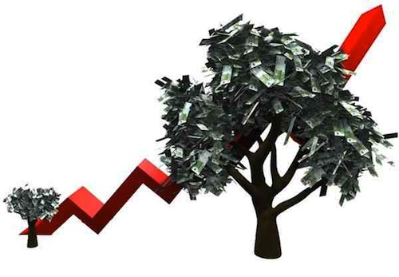
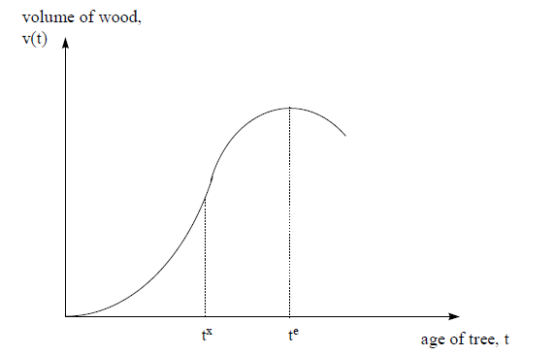
Biological Aspects
Growth pattern for a single tree
Maturity stage

Slide 32
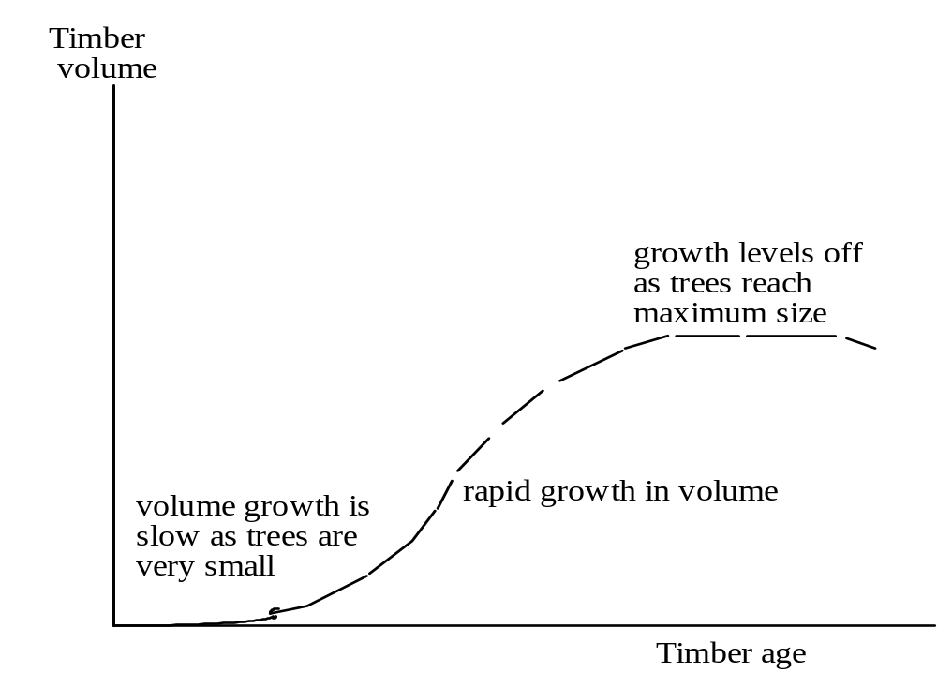
Growth Pattern Of Timber Volume

Slide 33
Forest volume is an increasing function of time before the point of biological maturity
After that volume declines
During the period of over maturity of stand which is characterized by volume reductions
Volume of Wood=f(time)

Slide 34
Properties of Growth Function
Current Annual Increment(CAI)
Mean Annual Increment(MAI)

Slide 35
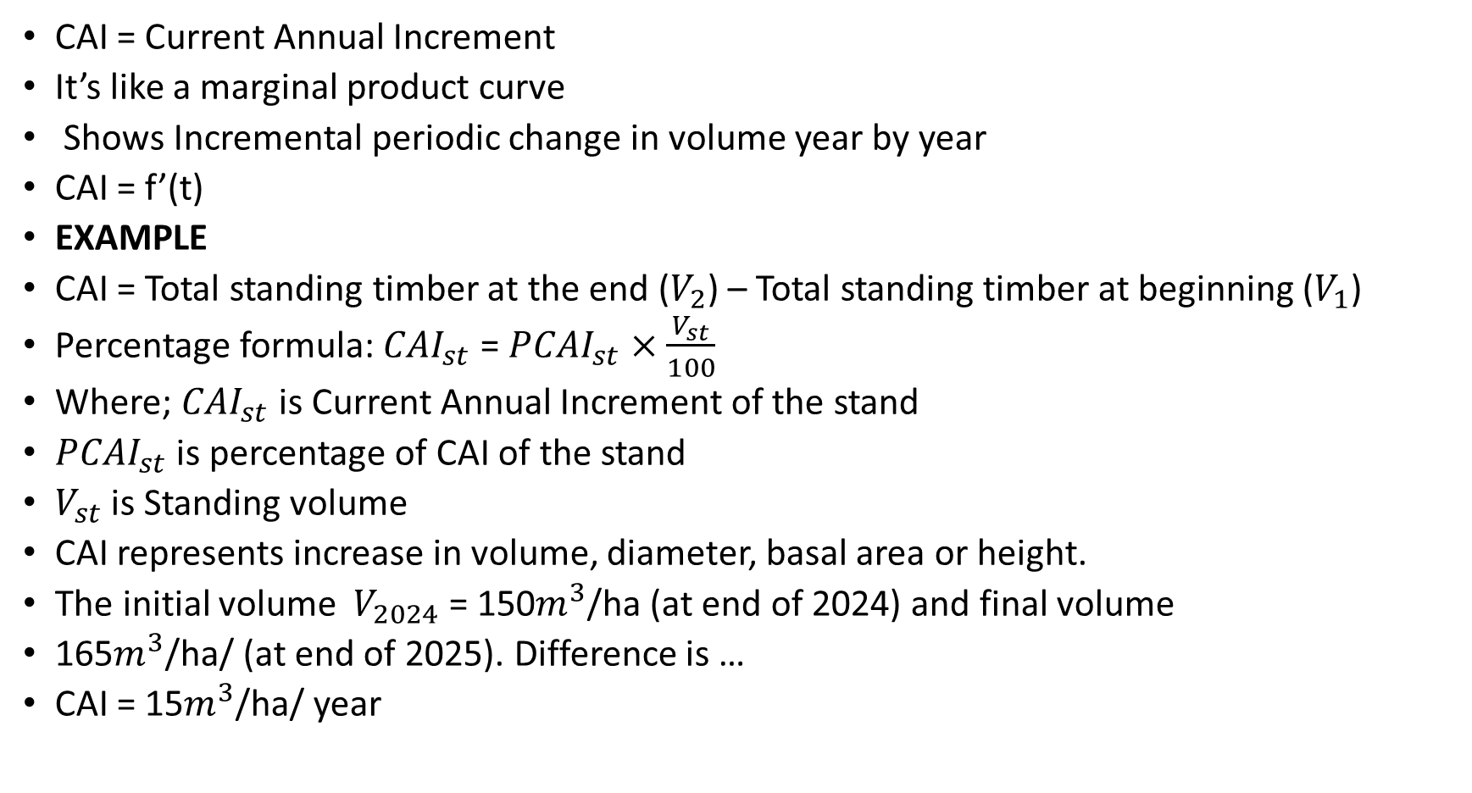
Current Annual Increment (CAI)
CAI = Current Annual Increment
It’s like a marginal product curve
Shows Incremental periodic change in volume year by year
CAI = f’(t)
EXAMPLE
CAI = Total standing timber at the end ($V_{2}$) – Total standing timber at beginning ($V_{1}$)
Percentage formula: ${CAI}_{st}$ = ${PCAI}_{st}$ $×$ $\frac{V_{st}}{100}$
Where; ${CAI}_{st}$ is Current Annual Increment of the stand
${PCAI}_{st}$ is percentage of CAI of the stand
$V_{st}$ is Standing volume
CAI represents increase in volume, diameter, basal area or height.
The initial volume $V_{2024}$ = 150$m^{3}$/ha (at end of 2024) and final volume
165$m^{3}$/ha/ (at end of 2025). Difference is …
CAI = 15$m^{3}$/ha/ year

Slide 36
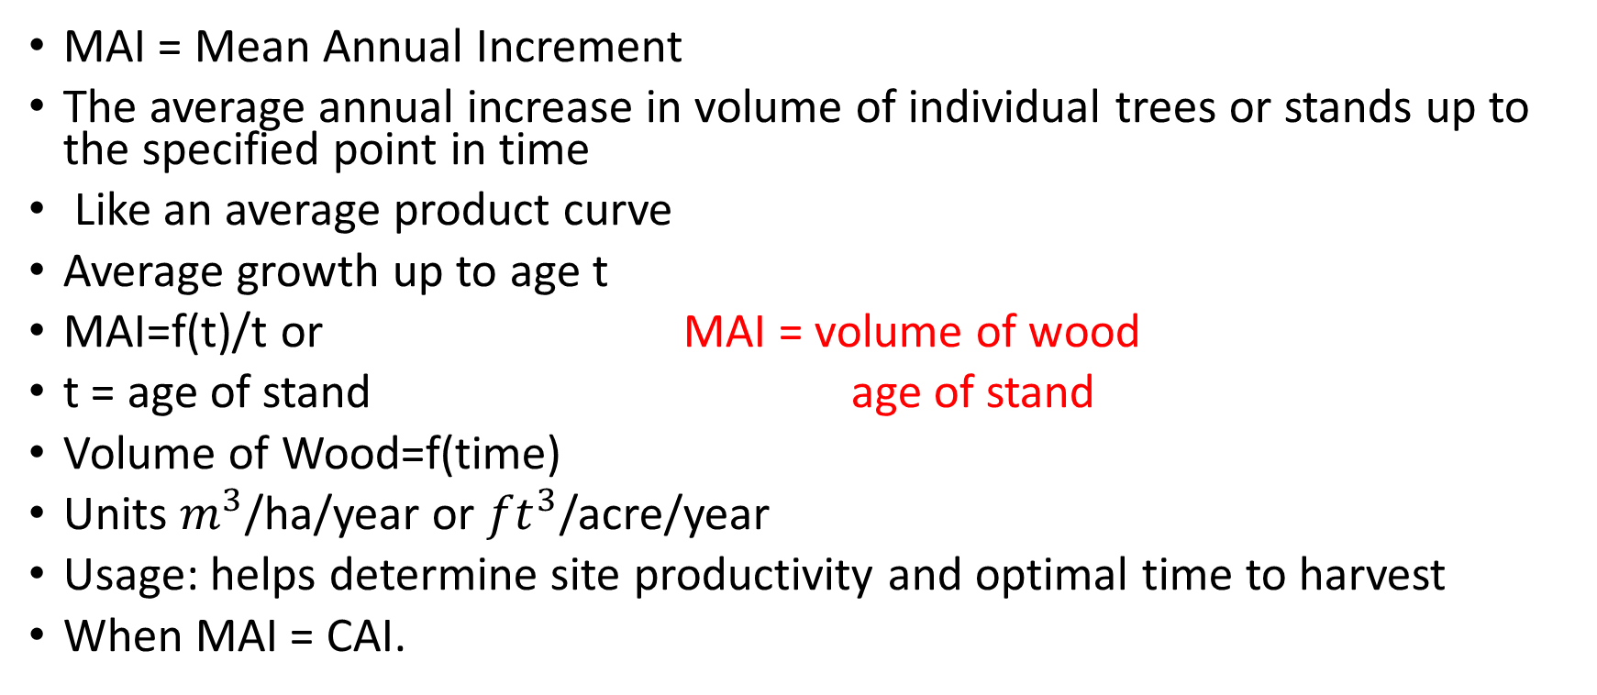
Mean Annual Increment (MAI)
MAI = Mean Annual Increment
The average annual increase in volume of individual trees or stands up to the specified point in time
Like an average product curve
Average growth up to age t
MAI=f(t)/t or MAI = volume of wood
t = age of stand age of stand
Volume of Wood=f(time)
Units $m^{3}$/ha/year or ${ft}^{3}$/acre/year
Usage: helps determine site productivity and optimal time to harvest
When MAI = CAI.

Slide 37
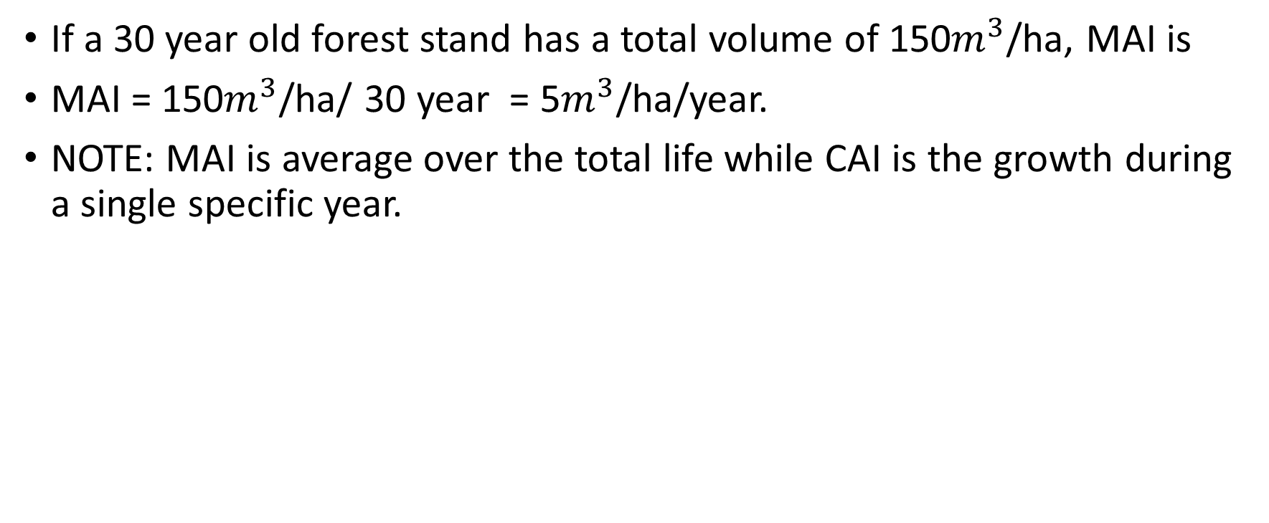
EXAMPLE CALCULATION MAI
If a 30 year old forest stand has a total volume of 150$m^{3}$/ha, MAI is
MAI = 150$m^{3}$/ha/ 30 year = 5$m^{3}$/ha/year.
NOTE: MAI is average over the total life while CAI is the growth during a single specific year.

Slide 38
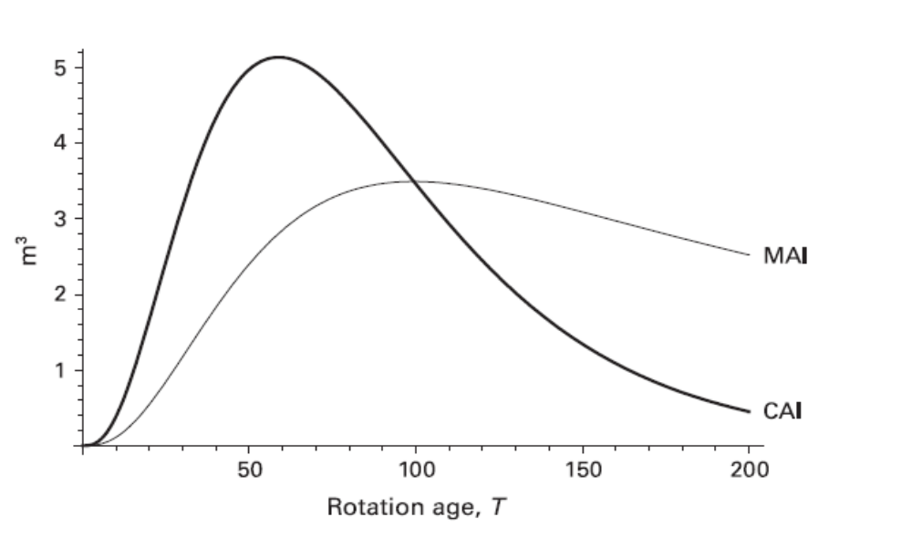
MAI and CAI

Slide 39
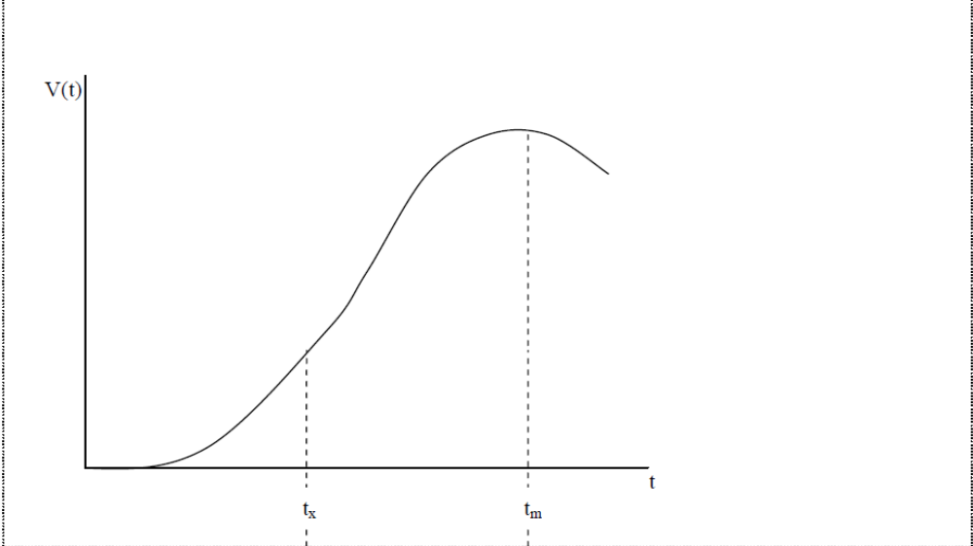

Slide 40
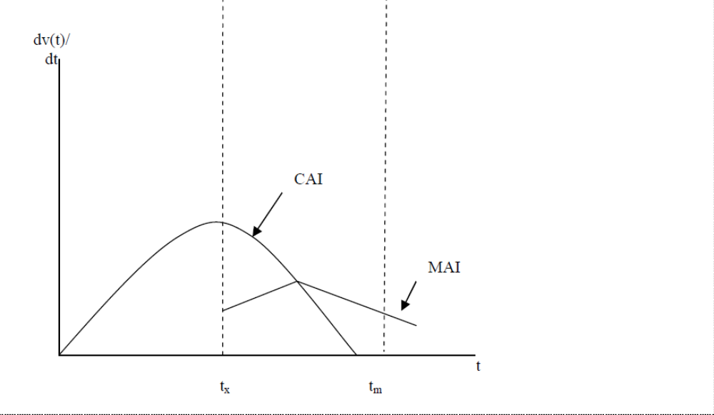

Slide 41
So, In biological point of view what is the optimum harvesting stage of timber ?
Harvest timber when forestry reach it’s maximum MAI

Slide 42
Economic Aspects
According to economic aspects, The purpose of Forestry is maximize economic rent
Economic rent:
Is any payment to a factor of production in excess of the cost needed to bring that factor into production
R_{f}= (P-C)V_{t}
R_{f} :Economic rent
P : Price of unit timber
C :Cost of unit timber
V_{t} :Volume of timber at t age

Slide 43
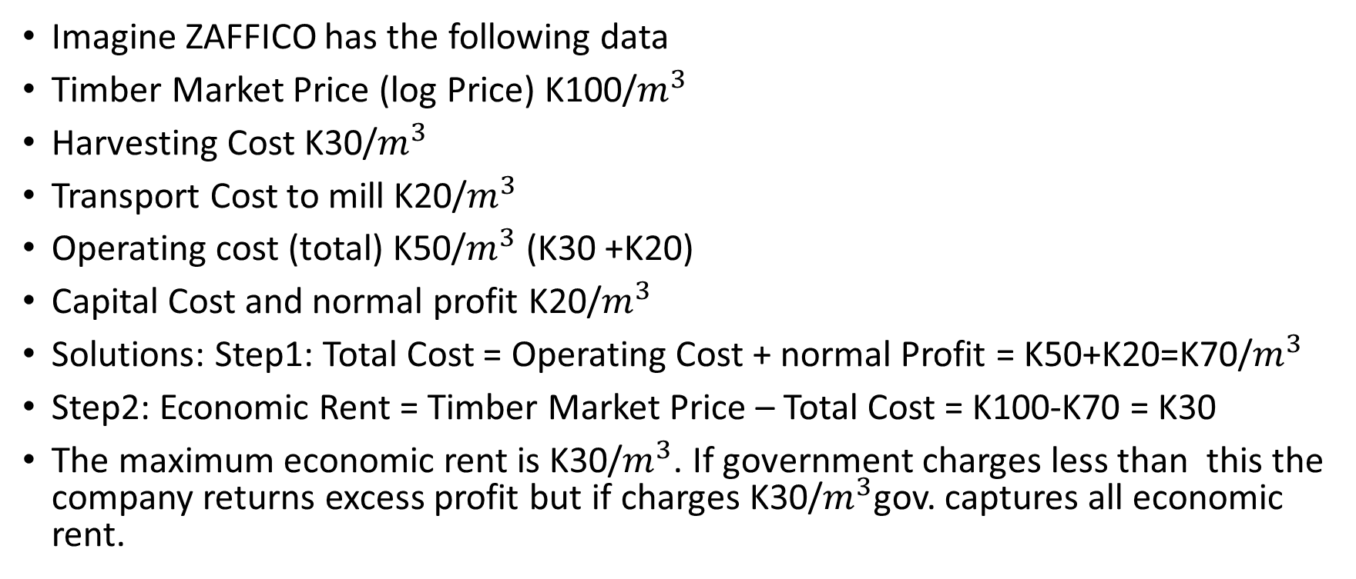
EXAMPLE OF ECONOMIC RENT IN FORESTRY
Imagine ZAFFICO has the following data
Timber Market Price (log Price) K100/$m^{3}$
Harvesting Cost K30/$m^{3}$
Transport Cost to mill K20/$m^{3}$
Operating cost (total) K50/$m^{3}$ (K30 +K20)
Capital Cost and normal profit K20/$m^{3}$
Solutions: Step1: Total Cost = Operating Cost + normal Profit = K50+K20=K70/$m^{3}$
Step2: Economic Rent = Timber Market Price – Total Cost = K100-K70 = K30
The maximum economic rent is K30/$m^{3}$. If government charges less than this the company returns excess profit but if charges K30/$m^{3}$gov. captures all economic rent.

Slide 44
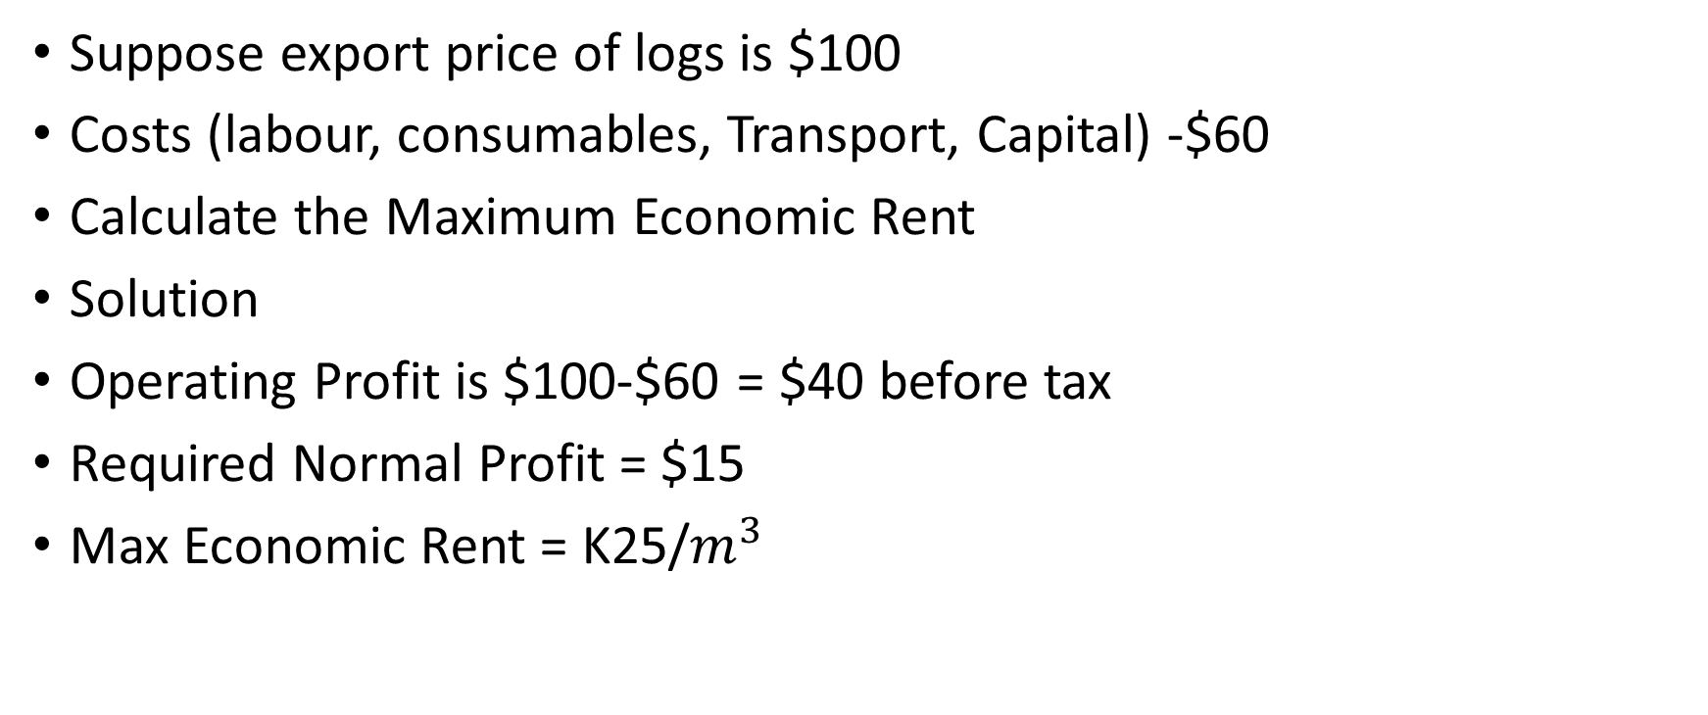
EXAMPLE OF ECONOMIC RENT IN FORESTRY
Suppose export price of logs is $100
Costs (labour, consumables, Transport, Capital) -$60
Calculate the Maximum Economic Rent
Solution
Operating Profit is $100-$60 = $40 before tax
Required Normal Profit = $15
Max Economic Rent = K25/$m^{3}$

Slide 45
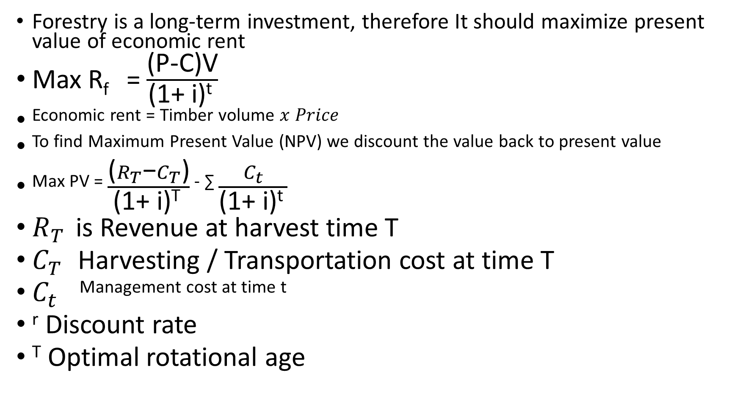
Forestry is a long-term investment, therefore It should maximize present value of economic rent
Max R_{f} = $\frac{\text{(}\text{P}\text{−}\text{C}\text{)}\text{V}}{\text{(1+ }\text{i}\text{)}\text{t} }$
^{Economic rent = Timber volume} $x Price$
To find Maximum Present Value (NPV) we discount the value back to present value
^{Max PV =} $\frac{\text{(}R_{T}\text{−}C_{T}\text{)}}{\text{(1+ }\text{i}\text{)}\text{T} }$ ^{- ∑} $\frac{C_{t}}{\text{(1+ }\text{i}\text{)}\text{t} }$
$R_{T}$ is Revenue at harvest time T
$C_{T}$ Harvesting / Transportation cost at time T
$C_{t}$ ^{Management cost at time t}
^{r} Discount rate
^{T} Optimal rotational age

Slide 46
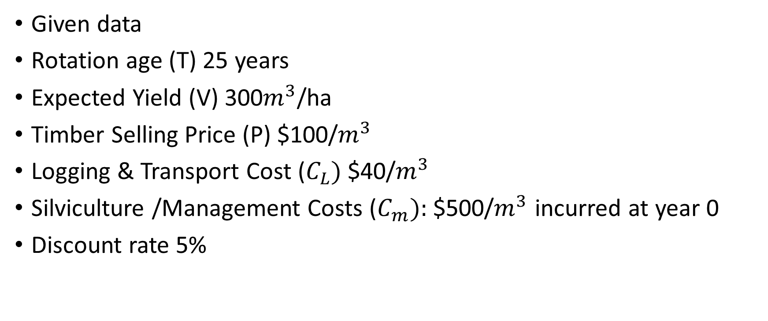
EXAMPLE ON SINGLE ROTATION
Given data
Rotation age (T) 25 years
Expected Yield (V) 300$m^{3}$/ha
Timber Selling Price (P) $100/$m^{3}$
Logging & Transport Cost ($C_{L})$$40/$m^{3}$
Silviculture /Management Costs ($C_{m}):$$500/$m^{3}$ incurred at year 0
Discount rate 5%

Slide 47
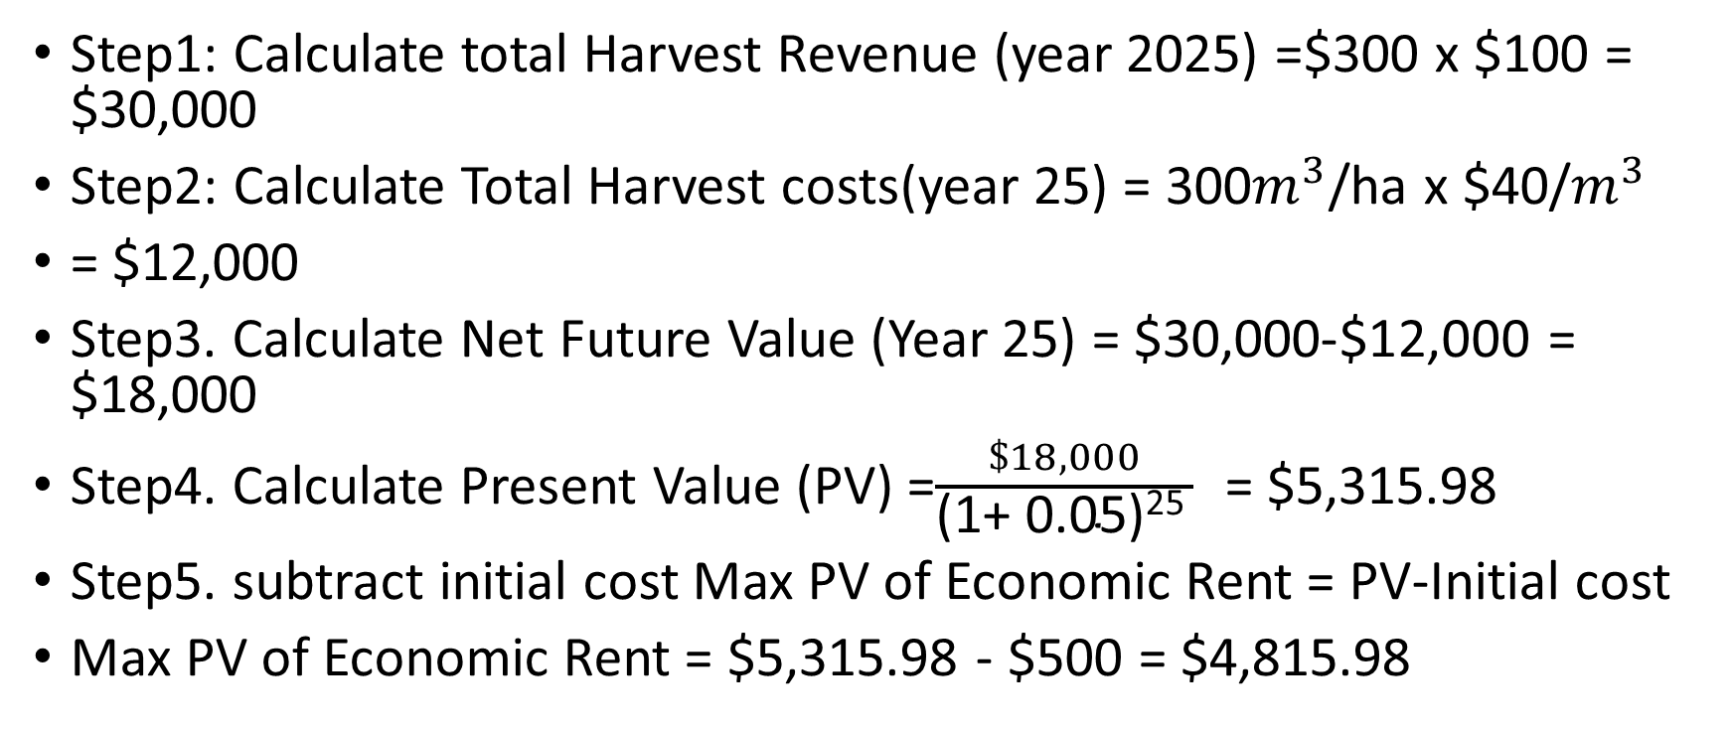
SOLUTION
Step1: Calculate total Harvest Revenue (year 2025) =$300 x $100 = $30,000
Step2: Calculate Total Harvest costs(year 25) = 300$m^{3}$/ha x $40/$m^{3}$
= $12,000
Step3. Calculate Net Future Value (Year 25) = $30,000-$12,000 = $18,000
Step4. Calculate Present Value (PV) =$\frac{\$18,000}{\text{(1+ }\text{0.05}\text{)}\text{25} }$ = $5,315.98
Step5. subtract initial cost Max PV of Economic Rent = PV-Initial cost
Max PV of Economic Rent = $5,315.98 - $500 = $4,815.98

Slide 48
Factors that missed when analyzing the problem in biological point of view;
Following costs are incurred when separating a forest as a cultivation land.
Maintenance cost
Opportunity cost
2. Forest cultivation is economically effective when economical rent of forest cultivation is greater than or equal to economical rent of other alternatives.

Slide 49
According to above factors optimum harvesting age can be calculated follows:
Marginal economic rent =
(increased timber volume X unit price of timber) – Cost
Growth rate of forestry is continuously changing, Thereby Marginal economic rent also change with the time
When consider one year of time, increased timber volume is that year’s Current Annual Increment (CAI)
When unit price of timber and cost are constant,
Marginal economic rate α CAI

Slide 50
Rotation Problem
A basic problem in forest economics is how long to let a tree grow before cutting it down
The answer is……
  Cut the trees down when they are growing at the rate of interest
The exact point at which our timber investment should be changed into another investment is when it has slowed down to a rate of growth exactly equal to the rate of interest
Rate of growth = Rate of interest

Slide 51
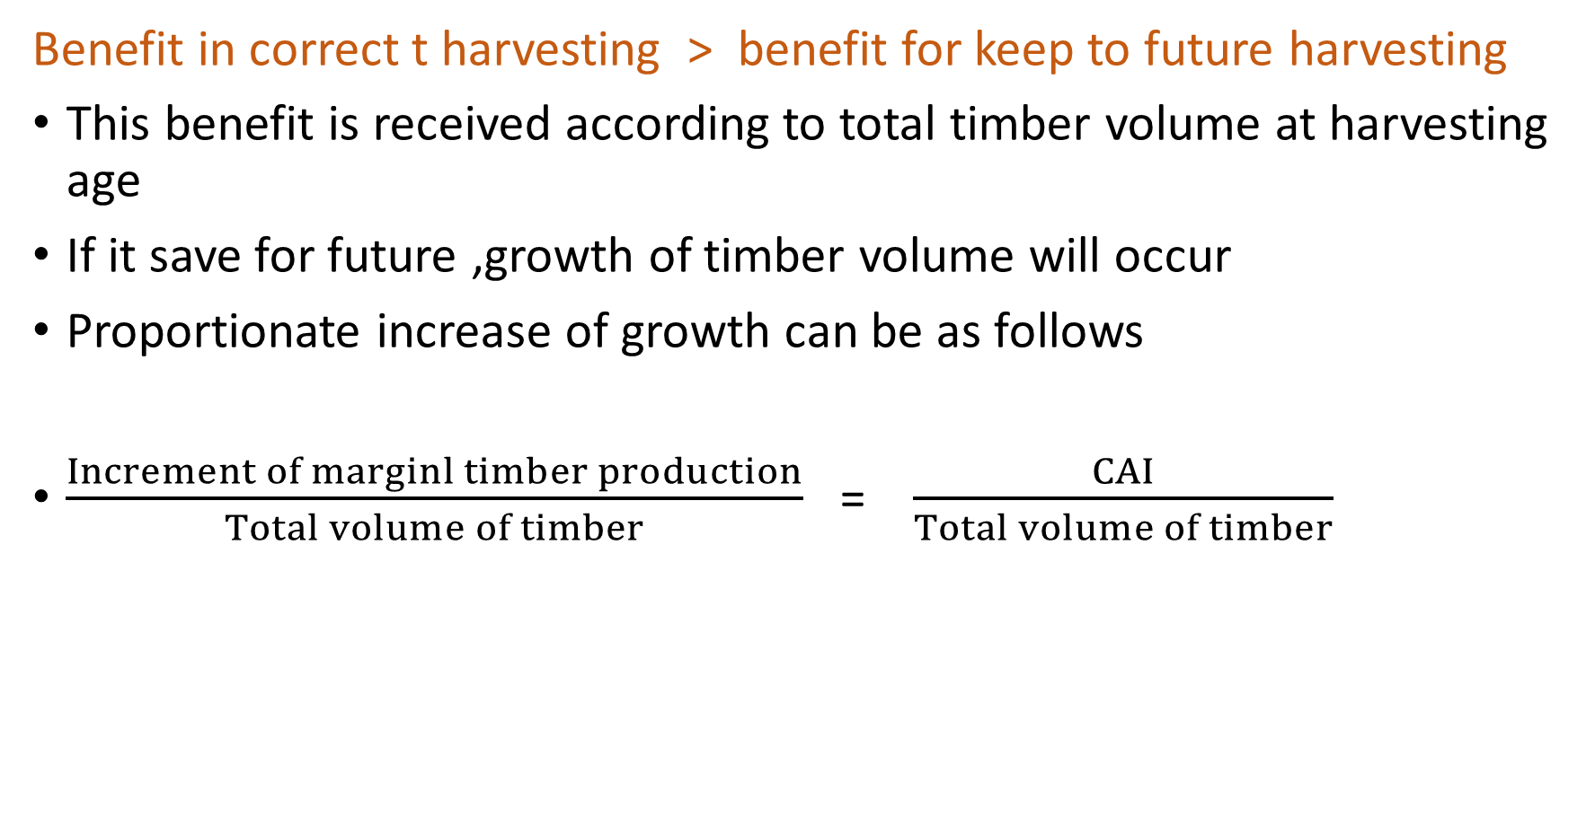
Benefit in correct t harvesting > benefit for keep to future harvesting
This benefit is received according to total timber volume at harvesting age
If it save for future ,growth of timber volume will occur
Proportionate increase of growth can be as follows
$\frac{Increment of marginl timber production}{Total volume of timber}$ = $\frac{CAI}{Total volume of timber}$

Slide 52
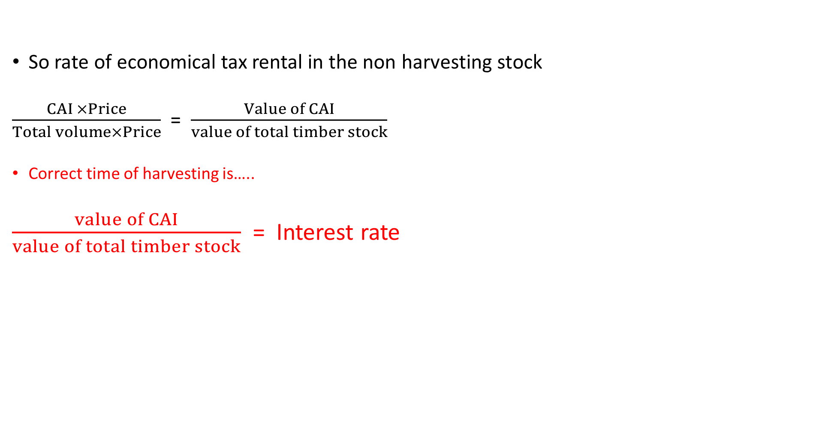
So rate of economical tax rental in the non harvesting stock
$\frac{CAI ×Price}{Total volume×Price}$ = $\frac{Value of CAI}{value of total timber stock}$
Correct time of harvesting is…..
$\frac{value of CAI}{value of total timber stock}$ = Interest rate

Slide 53
Optimal Rotation
The Maximum sustained yield (MSY) or the mean annual increment (MAI) is used by biologists to determine the optimal harvest age for timber
The allowable annual cut is usually based on the MSY concept
    Maximize MSY = f(T)/T
    0 = f(T)/T

Slide 54
Cutting rule can also use to explain optimum
Cutting rule is the current annual increment at harvest age meaning annual increment at harvest age
CAI = MAI
Clear cut the forest, when the current annual increment (CAI) is equal to the mean annual increment (MAI)
Nowadays, forestry is guided by this (or some similar rule) that is often justified to guarantee sustainability instead of economic efficiency.

Slide 55
Bioeconomic models
The analysis of the values of alternative uses of the forest is based on a bioeconomic model.
The biological component of the model describes the growth of the volume of timber over time on a hectare of forest land.
The economic component of the model places dollar values on the output of forested land under alternative patterns of use.

Slide 56
A Bioeconomic model is used to help determine an efficient management plan for the forest.
S(t) = p(t) x(t) - c(x(t))
Where
S(t): stumpage value
p(t): market value per unit (the "price") of biomass
x(t):is the quantity of biomass
c(x(t)): represents the cost of felling a hectare of timber and transporting it to market.

Slide 57
Single rotation model
It is used to show that the optimal rotation should be a period of time during the life of a forest stand in which the growth in value of the forest stock equals the market interest rate.
we do not have a continuous problem here… so, the question becomes:
Q: what is the optimal age at which to harvest?
→ is it the maximum of the MAI?
→ is it the maximum of the CAI?
→ what factors must be considered?

Slide 58

Maximize the Present Value of land:
• The single rotation model is referred to as the “Fisher Model”.
3 Principles
Cut the timber now and put the money in bank
Keep the stand of timber
Maintain the stand of trees as long as stumpage value is growing faster than rate of interest and then shifts assets to the bank

Slide 59

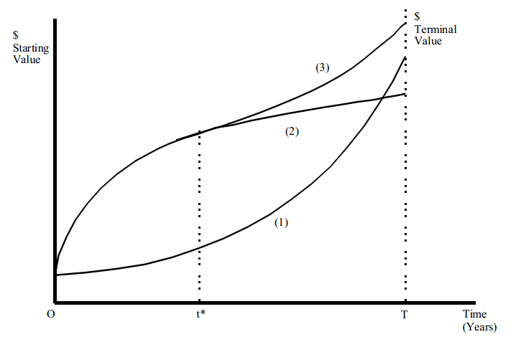

Slide 60
Faustmann model
Forest rent Theory
Forest rent has been a widely used criterion because the cutting rule favored a relatively long rotation
Forest rent was to avoid compounding and rotations
The forest rent approach includes timber prices and regeneration costs, which correspond to the Faustmann Model with a zero rate of interest

Slide 61
It excludes an alternative investment option and assumes that a forest owner does not have a loan
Land rent theory
The Faustmann Model (land rent theory) has become the best known for providing a benchmark model for determining optimal timber rotation age.

Slide 62
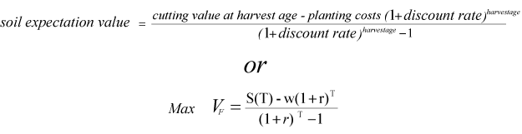

Faustmann Rule
• Assume an infinite number of rotations.
• Soil fertility, real prices and costs all remain constant over time.
• How does taking future land use into account alters our optimal harvest age.

Slide 63
The Hartman Model
Multiple Use Model
The conventional Faustmann Model does not reflect the value of services provided directly by the standing forest.
i.e. amenity values
wildlife habitat
erosion control
water cycle maintenance
Select the optimal rotation age to provide the combined net benefits from timber and other services of standing timber

Slide 64
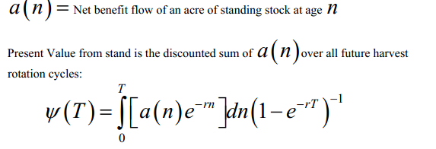
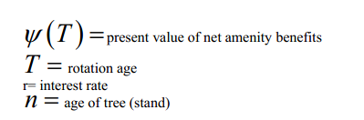

Slide 65
FISHERIES ECONOMICS
Fishery economics is a branch of economics that deals with the management, production, and sustainability of fisheries the commercial activity of catching, processing, and selling fish and seafood.
With over 3 billion people depending on fish as a primary source of protein and millions earning their livelihoods from fishing, the economic role of fisheries is vital.
However, the delicate balance between economic gain and environmental sustainability presents a growing global challenge

Slide 66
Economic importance of fisheries
Fisheries contribute significantly to national and global economies. According to the Food and Agriculture Organization (FAO), the fishing industry provides employment for more than 60 million people worldwide, both directly (fishers, processors) and indirectly (logistics, equipment, marketing).
In coastal and island nations, fisheries may constitute a major portion of the GDP and export revenues.

Slide 67
Economic importance of fisheries
Fish and seafood are also among the most traded food commodities globally.
Developing countries, in particular, rely on fishery exports for foreign exchange.
Beyond economic value, fisheries contribute to food security, nutrition, and cultural identity in many communities

Slide 68
Open access and the “tragedy of the commons”
Traditional economic models show that fisheries often operate under conditions of open access, meaning anyone can enter the fishery and harvest as much as they can.
While this may initially benefit communities through job creation, it often leads to overfishing a phenomenon where the fish population declines due to excessive harvesting.
This leads to the so-called “Tragedy of the Commons”, where individuals, acting in their own self-interest, deplete a shared resource, leaving everyone worse off in the long term.
Economically, this results in reduced catches, lower profits, rising operational costs, and ultimately the collapse of the fishery.

Slide 69
Maximum sustainable yield vs. maximum economic yield
In fishery economics, two critical concepts guide decisionmaking:
Maximum Sustainable Yield (MSY): The largest amount of fish that can be harvested annually without compromising the stock’s ability to replenish. It’s a biological concept rooted in ecological balance
Maximum Economic Yield (MEY): The level of effort that produces the highest possible economic return from a fishery. MEY generally requires less effort than MSY, as the cost of fishing increases with more intensive harvesting

Slide 70
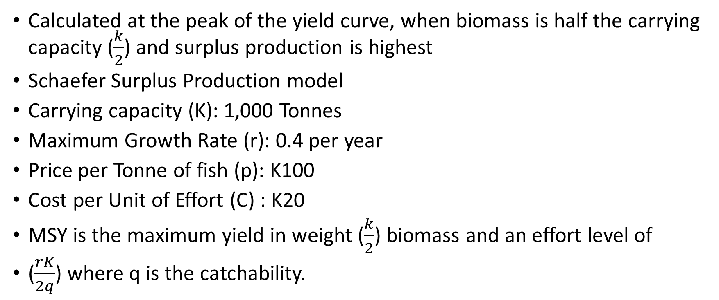
Maximum Sustainable Yield (MSY):
Calculated at the peak of the yield curve, when biomass is half the carrying capacity ($\frac{k}{2}$) and surplus production is highest
Schaefer Surplus Production model
Carrying capacity (K): 1,000 Tonnes
Maximum Growth Rate (r): 0.4 per year
Price per Tonne of fish (p): K100
Cost per Unit of Effort (C) : K20
MSY is the maximum yield in weight ($\frac{k}{2}$) biomass and an effort level of
($\frac{rK}{2q}$) where q is the catchability.

Slide 71
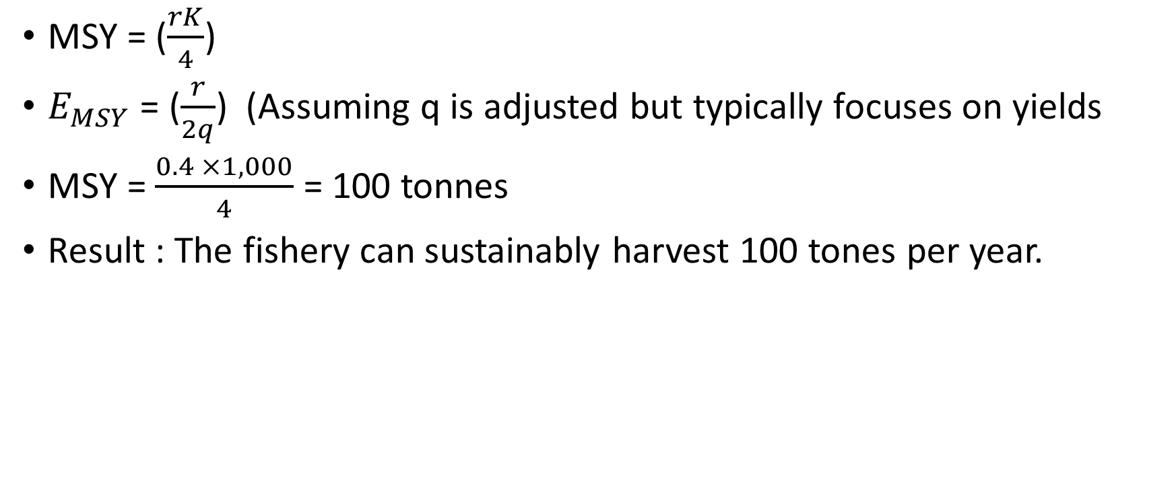
FORMULAS
MSY = ($\frac{rK}{4}$)
$E_{MSY}$ = ($\frac{r}{2q}$) (Assuming q is adjusted but typically focuses on yields
MSY = $\frac{0.4 ×1,000}{4}$ = 100 tonnes
Result : The fishery can sustainably harvest 100 tones per year.

Slide 72
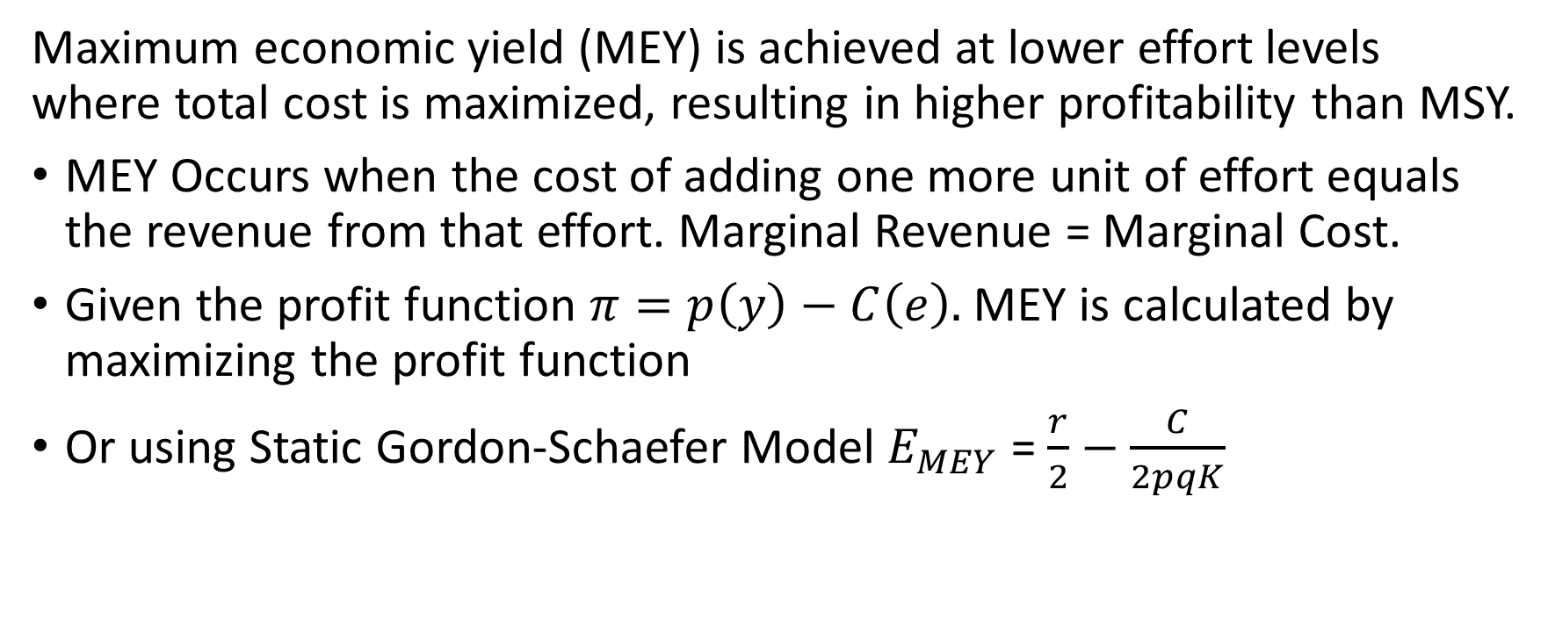
Maximum Economic Yield (MEY):
Maximum economic yield (MEY) is achieved at lower effort levels where total cost is maximized, resulting in higher profitability than MSY.
MEY Occurs when the cost of adding one more unit of effort equals the revenue from that effort. Marginal Revenue = Marginal Cost.
Given the profit function $π=p\left(y\right)−C\left(e\right).$MEY is calculated by maximizing the profit function
Or using Static Gordon-Schaefer Model $E_{MEY}$ = $\frac{r}{2}−\frac{C}{2pqK}$

Slide 73
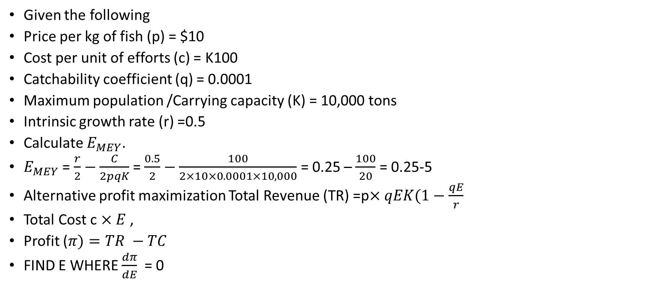
EXAMPLE ON MEY
Given the following
Price per kg of fish (p) = $10
Cost per unit of efforts (c) = K100
Catchability coefficient (q) = 0.0001
Maximum population /Carrying capacity (K) = 10,000 tons
Intrinsic growth rate (r) =0.5
Calculate $E_{MEY}$.
$E_{MEY}$ = $\frac{r}{2}−\frac{C}{2pqK}$ = $\frac{0.5}{2}−\frac{100}{2×10×0.0001×10,000}$ = 0.25 – $\frac{100}{20}$ = 0.25-5
Alternative profit maximization Total Revenue (TR) =p$×qEK(1−\frac{qE}{r}$
Total Cost c $×E$ ,
Profit ($π)=TR −TC$
FIND E WHERE $\frac{dπ}{dE}$ = 0

Slide 74
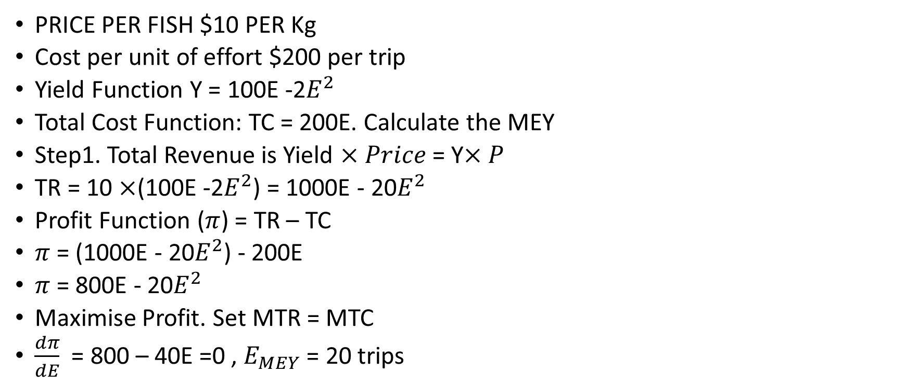
CALCULATION
PRICE PER FISH $10 PER Kg
Cost per unit of effort $200 per trip
Yield Function Y = 100E -2$E^{2}$
Total Cost Function: TC = 200E. Calculate the MEY
Step1. Total Revenue is Yield $×Price$ = Y$×P$
TR = 10 $×$(100E -2$E^{2}$) = 1000E - 20$E^{2}$
Profit Function ($π$) = TR – TC
$π$ = (1000E - 20$E^{2}$) - 200E
$π$ = 800E - 20$E^{2}$
Maximise Profit. Set MTR = MTC
$\frac{dπ}{dE}$ = 800 – 40E =0 , $E_{MEY}$ = 20 trips

Slide 75
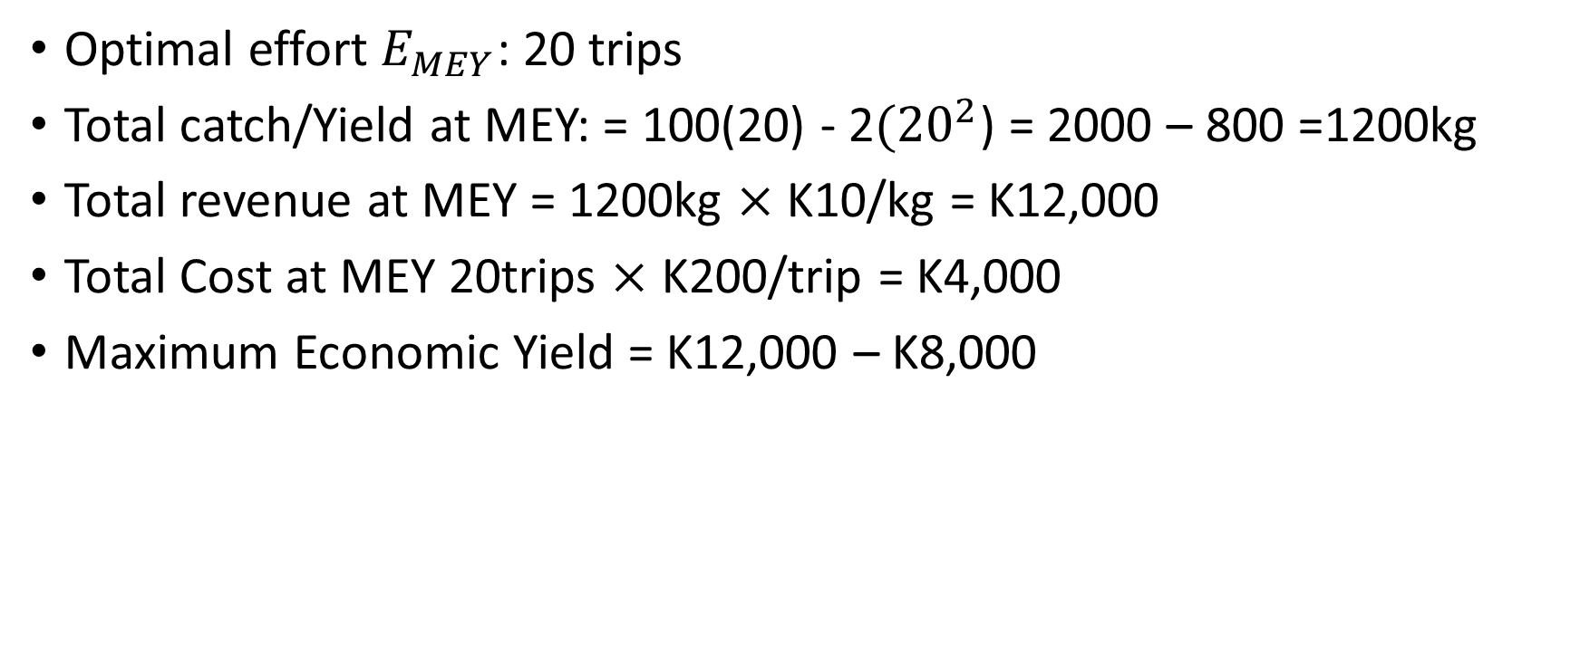
Calculate the MEY METRICS
Optimal effort $E_{MEY}$: 20 trips
Total catch/Yield at MEY: = 100(20) - 2${(20}^{2}$) = 2000 – 800 =1200kg
Total revenue at MEY = 1200kg $×$ K10/kg = K12,000
Total Cost at MEY 20trips $×$ K200/trip = K4,000
Maximum Economic Yield = K12,000 – K8,000

Slide 76
Maximum sustainable yield vs. maximum economic yield
Economists argue that targeting MEY rather than MSY is both more sustainable and more profitable in the long run. However, achieving MEY requires regulation, monitoring, and sometimes a reduction in fishing effort—moves that can be politically and socially sensitive.

Slide 77
Market Forces in Fisheries
Fish markets operate under complex supply-and-demand conditions influenced by:
• Seasonality and weather conditions
• Stock abundance and variability
• Consumer preferences and dietary trends
• International trade policies and tariffs
• Technological advancements in fishing gear and storage
Price volatility is common in fisheries, especially in wild capture fisheries where supply is less predictable.
In contrast, aquaculture (fish farming) has added stability and growth to the sector, now accounting for over half of the fish consumed globally.

Slide 78
Economic tools for sustainable fisheries
Governments and international bodies use a range of economic tools to manage fisheries and avoid overexploitation:
Regulating the amount of fish that can be caught annually helps maintain fish stocks.
These can be assigned to individuals or groups as Individual Transferable Quotas (ITQs), which can be bought or sold.
Fishing licenses and effort controls: Limiting the number of
boats, fishing days, or types of gear helps control effort and reduce pressure on resources.
Subsidy reforms: Many countries provide subsidies to fishers, but poorly targeted subsidies can encourage overfishing.
Reforms are aimed at redirecting funds toward sustainability and
conservation efforts.

Slide 79
Economic tools for sustainable fisheries
Marine Protected Areas (MPAs): Setting aside no-fishing zones can allow fish stocks to recover and even spill over into adjacent fishing areas, increasing overall productivity.
Economic Incentives and co-management: Encouraging communities to manage their local fisheries through co-management and providing economic incentives for sustainable practices helps align short-term behavior with long-term goals.
Global Challenges and the Path Forward: Global fish stocks are
under increasing stress. According to the FAO, over 35% of global fish stocks are overexploited, with climate change, illegal fishing, and habitat degradation adding further pressure

Slide 80
Fishery economics thus faces several key challenges
• Designing effective policies that balance ecological sustainability and economic viability
• Ensuring equity among small-scale fishers and large industrial operators
• Incorporating climate change projections into resource management
• Enhancing data collection and enforcement capabilities
The shift toward Ecosystem-Based Fisheries Management (EBFM)—which considers environmental, social, and economic factors—marks a positive direction for the future

Slide 81
CONCLUSION
Fishery economics lies at the intersection of ecology, livelihood, and trade.
It plays a central role in shaping policies that ensure the sustainable use of one of the planet’s most valuable renewable resources.
By combining sound economic principles with environmental stewardship and community involvement, it is possible to manage fisheries in a way that secures both economic benefits and ocean health for future generations.

